Slide 1
Physics 3 – Oct 25, 2019
Do Now: P3 Challenge –
1) What percentage light intensity would result by placing two polaroid papers oriented at 0 and 90 degrees to the vertical?
2) What total percentage light intensity (let I would result by placing three polaroid papers oriented at 0, 30 and 90 degrees to the vertical?
Get out 19-24 for hmk checks

Slide 2
Objectives/Agenda/Assignment
Objective:
4.4 Wave behavior – Wave optics
Agenda:
Reflection and refraction
Snell’s law, critical angle and total internal reflection
Assignment: p181 #25-28

Slide 3
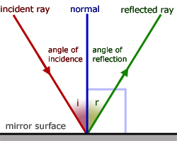
Ray Optics
One simple way to represent light from a source is by using an arrow to represent the direction of a single ray.
Recall rays are normal to the wave fronts.
Ray diagrams are useful when describing how light reflects from surfaces and refracts through different media.
For reflection, the incident ray angle to the normal of the surface equals the reflected ray angle to the normal of the surface, as shown.
θ
θ

Slide 4
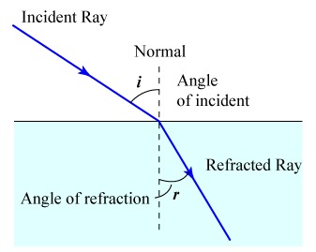
Refraction / Snell’s Law
When light passes through a medium with a larger index of refraction, n, the light ray will bend toward the normal.
A Normal = a line perpendicular to the surface
The magnitude of the change in direction is determined by Snell’s law
$n_{1}\text{sin}θ_{1}=n_{2}\text{sin}θ_{2}$
θ
θ

Slide 5
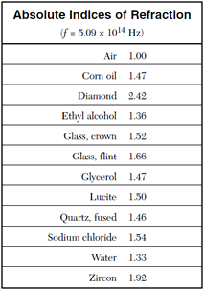
Sample Problems
Determine the angle of the reflected ray and the angle of the refracted ray when a beam of light is incident on the surface of a lake at 50 degrees to the normal. Draw a ray diagram.
A person whose eyes are 1.62 m above the floor stands 2.10 m in front of a vertical plane mirror whose bottom edge is 43 cm above the floor. What is the horizontal distance to the base of the wall supporting the mirror of the nearest point on the floor that can be seen reflected in the mirror?

Slide 6
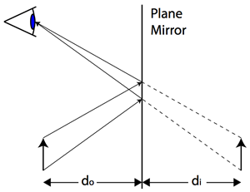
Image formation
What we see in a mirror is a virtual image that appears to be located the exact same distance behind the mirror, d_{i} as the actual image is located in front of the mirror, d_{o}.
d_{i} = d_{o}
The light coming from all points along the object obey the law of reflection.
Our mind interprets these reflected rays as if they originated along straight lines from the location of the virtual image.
It is called a virtual image because there are no light rays present at the location of the image.

Slide 7
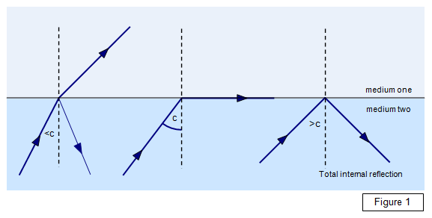
Total internal reflection
Consider a light ray traveling within a medium with a relatively high index of refraction approaching a boundary with a low index of refraction such as air.
Because the light ray bends away from the normal at the boundary, there are three possible results.
Refracted ray (Snell’s Law)
Critical angle ($n_{1}\text{sin}θ_{c}=n_{2}$)
Total internal reflection (no refraction)
At every media boundary, there will be a reflection as well as a possible refraction.
Used in fiber optic cables.

Slide 8
Rainbows and Crystals
Crystals can be used to create rainbows because the index of refraction of a medium depends on wavelength. This phenomenon is called dispersion.
How? Consider a particle of the medium at the interface. The frequency of oscillation of this point can only be one value, and must match the incident frequency and the refracted frequency. Frequency does not change.

Slide 9
Rainbows and Crystals
For any given frequency of light, $\frac{n_{1}}{n_{2}}=\frac{c_{2}}{c_{1}}=\frac{λ_{2}f}{λ_{1}f}$ so $\frac{n_{1}}{n_{2}}=\frac{λ_{2}}{λ_{1}}$
Frequency does not change at the boundary.
One can interpret this equation in two ways. For a given light ray with a specified wavelength, its wavelength will change depending on the relative index of refractions .
For white light, that is a mixture of wavelengths, different color wavelengths will appear to bend differently: rainbows!
We call this phenomenon Dispersion.

Slide 10
Sample Problem
A horizontal laser beam with wavelength of 645 nm enters the hypotenuse side of a 45-45-90 rectangular crown glass prism lying on its side. (n = 1.52)
A) What is the angle of refraction?
B) What is the speed of the light within the prism?
C) What is the wavelength of the laser within the prism?
D) What is the deviation angle upon exiting the prism?
E) What is the wavelength of the light upon exiting?

Slide 11
Exit slip and homework
Exit Slip – A horizontal laser beam enters the hypotenuse side of a 30-60-90 rectangular crown glass prism lying on its side as shown. (n = 1.52)
What is the angle of refraction?
What’s due? (homework for a homework check next class)
p181 #25-28
What’s next? (What to read to prepare for the next class.)
Snell’s Law required lab 4.4 Determining refractive index experimentally

